Slide 1





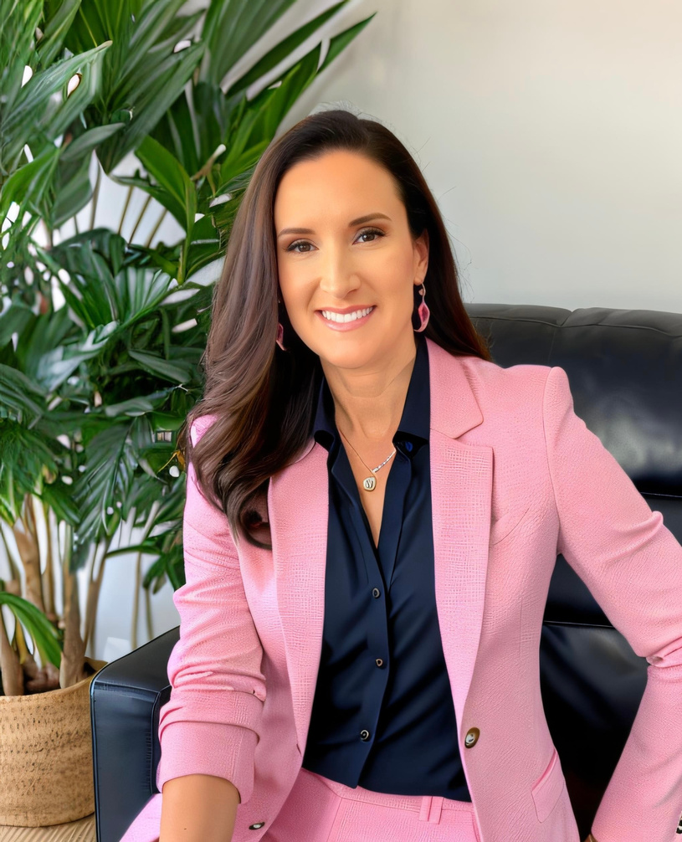

SUMMER VYNE - CEO
2024 SMALL BUSINESS LEADER OF THE YEAR

Slide 2


TABLE OF CONTENTS
SBLY 2024
APPLICATION & QUALIFICATIONS 3
GROWTH 9
BIOGRAPHY 4
INNOVATION 10
COMPANY INFO 5
STATEMENT OF MERIT 11
PHILOSOPHY 6
RECOMMENDATIONS 12-14
MANAGEMENT 7
CASE STUDIES 15
COMMUNITY INVOLVEMENT 8
RECOGNITIONS 16
Summer Vyne
02 of 17

Slide 3

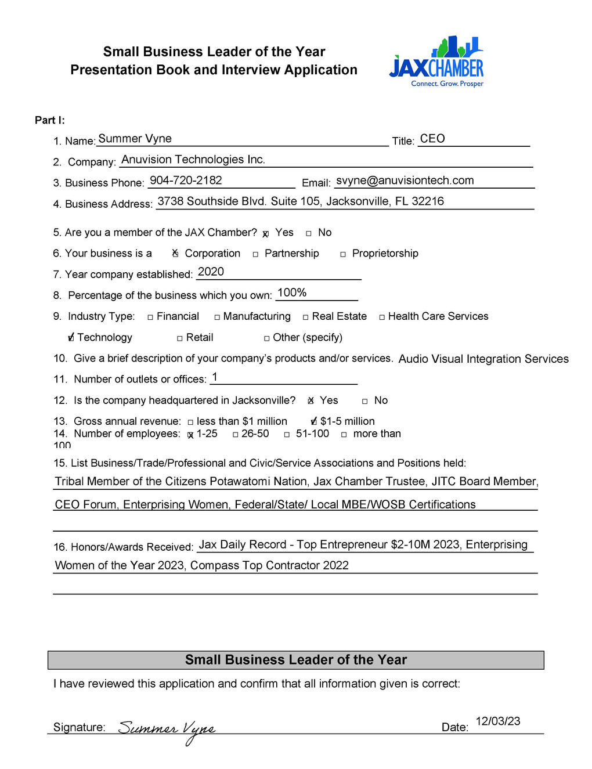
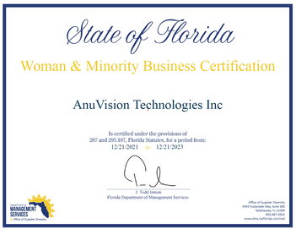
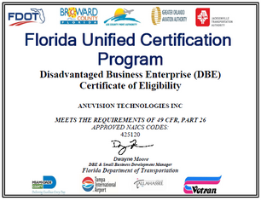


APPLICATION
& QUALIFICATIONS
As a Native American women owned business in the Audio Visual industry I carry certifications that assist our clients in reaching their goals.
Supplier Diversity Certifications:
Florida Unified Certification
FDOT/JTA/Broward County/Lee County Port Authority/Greater Orlando Aviation Authority/Miami Dade County
Tampa International Airport/City of Tallahassee/Votran: Certified Disadvantage Business Enterprise (DBE)
City of Jacksonville (JSEB) - Certified Minority Woman Owned Disadvantaged Business
City of Orlando - Certified MWBE #21143088
City of Tampa/Hillsborough County - Certified Women Minority Business Enterprise (WMBE)
State of Florida OSD: Certifed Women and Minority Business (WMBE)
National WBENC: Certified Women Business Enterprise (WBE) #WBE2200235
National WBENC: Certified Women Owned Small Business (WOSB) #WOSB220198
Duval County Public Schools - Certified SBE, MWBE, MBE Enterprise
ISBEE - Indian Small Business Economic Enterprise
Summer Vyne
03 of 17

Slide 4

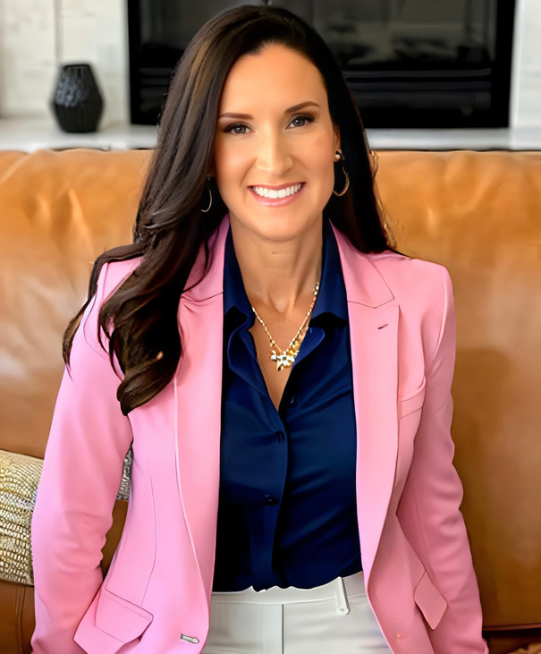
BIOGRAPHY
The Birth of Anuvision Technologies Inc.
My entrepreneurial spirit could not be dampened. I went on to establish Anuvision Technologies Inc., an endeavor that would become a beacon of success in the AV technology sector. Under my leadership, the company has thrived and gained recognition for its innovation, commitment to quality, and dedication to its employees and clients. My leadership skills have been instrumental in the growth, pivot, and thriving of the organization, especially given the challenging circumstances in its early years. I started the company in April 2020, right when the pandemic hit, and communities were grappling with shutdowns and economic uncertainty.
In the first year of operation, AnuVision Technologies faced significant challenges, including low revenue and market uncertainty due to the pandemic's impact on businesses worldwide. I had to exhibit remarkable resilience and adaptability during this period, making tough decisions to cut costs while ensuring the well-being of employees. I was able to steer the company through difficult times by implementing innovative strategies, focusing on remote work, and realigning the company's offerings to cater to the changing needs of clients in the digital landscape.
Despite the initial setbacks, my commitment to the organization's vision and unwavering belief in the team's capabilities enabled the company to navigate the turbulent waters of the pandemic successfully. As the world slowly recovered from the crisis, we experienced remarkable growth in the following year, achieving a remarkable 20% increase in revenue. Having a strategic vision and the ability to identify emerging opportunities played a pivotal role in capitalizing on the market's shifting demands and ensuring the company's long-term sustainability.
Continuing the trajectory of success, I was able to lead AnuVision Technologies to even greater heights the subsequent year, with an impressive 27% growth in revenue. Through my exceptional leadership, I fostered a culture of innovation and adaptability within the organization, allowing us to stay ahead of competitors and capitalize on emerging market trends effectively.
Aerial Arts and Community Engagement
Beyond my entrepreneurial ventures, I realized a dream of having a place to train and perform, so I started a unique Aerial Arts studio in Jacksonville. The studio, the first of its kind in Florida, has flourished for over a decade and has become a cherished community space.
My life journey from a small Texas town to becoming a Small Business Leader nominee is a testament to my spirit, resilience, and unwavering commitment to excellence. My story serves as an inspiration to aspiring entrepreneurs and leaders, demonstrating that with determination and passion, one can overcome adversity and achieve extraordinary success.
SUMMER VYNE
As a visionary entrepreneur and dedicated small business leader, I have embarked on a remarkable journey from humble beginnings to becoming a prominent figure in the business world. I was born and raised in a small town in Texas, I experienced a tough childhood, but my life story is a testament to my resilience, determination, and unwavering commitment to succeed. With a bachelor’s degree in business management and leadership and a wealth of experience in both the financial and technology sectors, I have built a thriving career in AV technology, all while overcoming personal challenges and achieving remarkable success.
The Early Years
I was born and raised in a small town in Texas, where I was brought up by my father. In middle school, a pivotal move to Phoenix, Arizona, brought me living with my mother which presented new opportunities and challenges.
The Pursuit of Education and Independence
At just 17 years old I made the bold decision to strike out on my own, embarking on a journey towards self-sufficiency. While working full-time I also put myself through college, earning a bachelor’s degree in business management and leadership.
Career Beginnings
My career journey commenced in the financial sector, working at First Interstate Bank, which was later acquired by Wells Fargo. However, I was drawn to the world of Information Technology and joined the Arizona Department of Education. This marked the first step towards a career shift that would lead to groundbreaking achievements.
The Leap into AV Technology
An exciting chapter in my life began when I joined CCS Presentation Systems, launching my career in AV technology. During this time, I started a family and became a parent to my beloved daughter, who became the center of my world. Life took a challenging turn with a divorce, leading to a crucial decision to relocate to Jacksonville, Florida, a move that ultimately shaped my future.
Entrepreneurial Spirit
Transferring with my employer to Jacksonville, I recognized an opportunity to become an entrepreneur. I was able to co-found CSI, a venture that achieved record-breaking sales within just three years. Unfortunately, the business had to close due to unforeseen challenges with my partner's business practices. I, however, demonstrated remarkable leadership by ensuring that all staff in both the Jacksonville and Orlando markets found employment with reputable companies as well as helping customers finish their projects.
Summer Vyne
04 of 17

Slide 5







COMPANY
INFO
AV S
WHO ARE WE?
AA
AnuVision Technologies Inc. is a full-service audio-visual design and integration firm founded by skilled professionals with over 30 combined years of experience in providing Audio Visual and Technology services for Fortune 50 companies, Local, State, and Federal Government entities, as well as Universities and K-12 Education institutions. We strive to provide the best possible outcomes, giving our clients technology solutions that are simple, innovative, and reliable.
I was able to create a custom program, AVT Shield, to assist clients to grow and evolve their AV technology within their organizations. AV-as-a-Service (AVaaS) is an exclusive way to pay for your audiovisual solution that bundles your equipment and support services into one low monthly subscription payment. AVaaS provides your organization with more freedom, control, and flexibility than any other payment options available; including cash purchases and traditional leasing. With AVaaS, you remain at the forefront of technology so you can stay competitive, preserve precious capital, and never worry about obsolete technology holding you back.
COMPANY CERTIFICATIONS
I believe in continuing our professional development to keep our team on top.
  Industry Standard AVIXIA
  Crestron
  Extron
  QSC
  BIAMP
  Shure
Summer Vyne
05 of 17

Slide 6


FINANCIAL IT
Leadership
My leadership philosophy was centered on prioritizing the well-being of my employees in a high-stress environment where we frequently dealt with upset customers. Many days, I found myself acting as a counselor, recognizing the importance of supporting my team's emotional resilience.
1992
Philosophy
EDUCATION IT
1997
Transitioning to a smaller, specialized team dedicated to supporting the education system, my leadership focus evolved to enhance the skills and capabilities of our workforce as well as the customers we serviced. Spearheaded the development of training programs and support solutions.
I believe that true leadership is rooted in authenticity, integrity, and a deep commitment to the growth and well-being of those I lead. Business revolves around adaptability, ethics, and innovation.
Acknowledging the ever-changing business landscape, it is important to prioritize the ability to meet evolving needs by staying on the cutting edge and adjusting quickly. At the same time, keeping in mind ethical conduct and emphasizing the importance of doing the right thing to build trust and maintain a positive reputation toward employees, clients and community partners.
Commitment to innovation involves fostering a creative culture and staying in front of industry trends. Leadership, rooted in authenticity and integrity, ensures a transparent and trustworthy approach; which ultimately contributes to a positive work environment and long-term success.
AUDIO VISUAL IT
Transitioning to a career in AV, my leadership philosophy shifted towards optimizing technical excellence and delivering immersive experiences. I embraced a role where creativity and technical precision converged, emphasizing the importance of harnessing innovation, fostering collaboration, and ensuring seamless execution to elevate impact of AV solutions in diverse settings.
2001
ENTREPRENEUR
2012
Faced with failure, I led with a steadfast commitment to the well-being of all employees, ensuring their job security and livelihoods. My leadership approach prioritized transparency, open communication, and strategic decision-making, ultimately safeguarding the team's future and fostering a culture of resilience and collective determination.
ANUVISION TECH
My leadership philosophy centers on providing unparalleled customer experiences through cutting-edge technology and exceptional service. I am committed to cultivating a culture of innovation and client-centricity, where adaptability, creativity, and attention to detail drive the success of our business and exceed the expectations of our clients.
2020
Summer Vyne
06 of 17

Slide 7
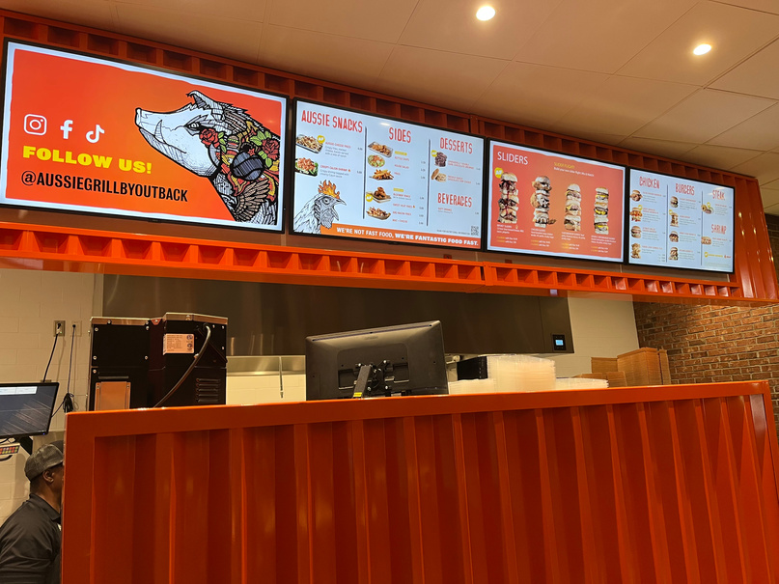
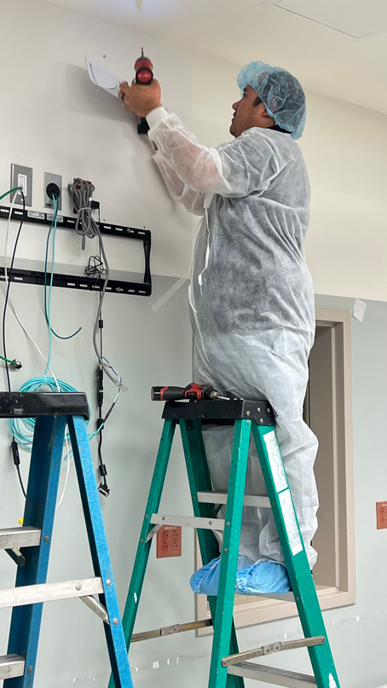
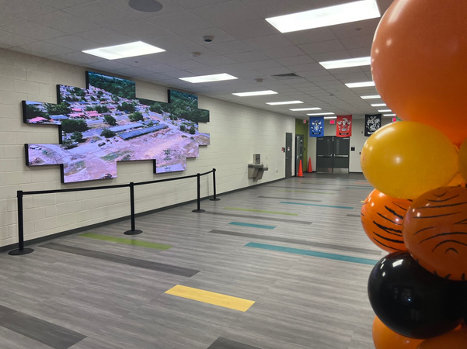
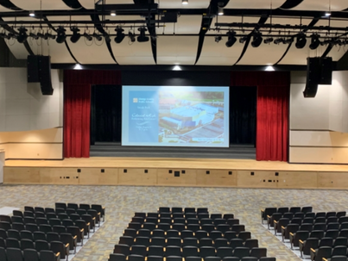
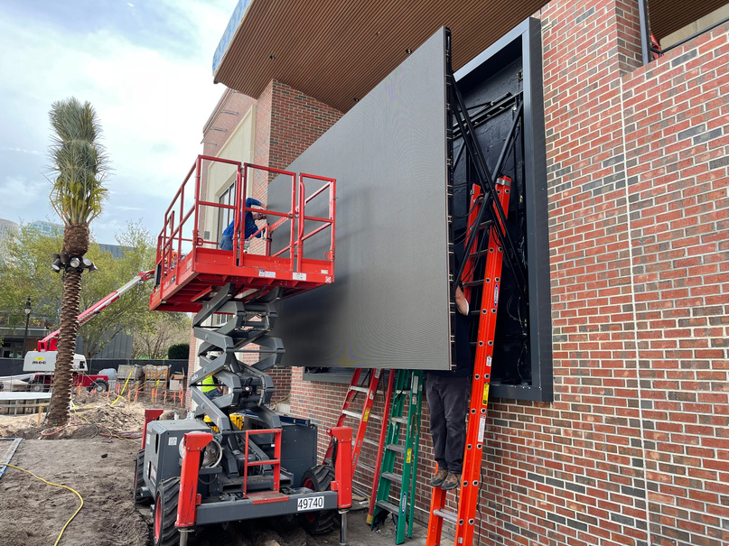

MANAGEMENT
AS A LEADER
My approach to management and leadership is characterized by a steadfast commitment to nurturing a culture of innovation, collaboration, and excellence. I firmly believe that a successful organization thrives when its team members are empowered and inspired to reach their full potential. As a leader, I prioritize transparency and open communication, ensuring that every member of our team understands our vision, goals, and their vital role in achieving them. I encourage creative thinking, welcoming new ideas and perspectives, and fostering an environment where innovation and creativity can flourish. Through mentorship and support, I aim to guide our team members in their professional development, helping them build fulfilling careers within our organization. Additionally, I emphasize the importance of adaptability and resilience in the ever-evolving technology landscape, inspiring our team to tackle challenges head-on and continually strive for excellence. Ultimately, my management and leadership style at Anuvision Technologies is dedicated to driving the success of our organization while also enriching the lives and careers of our valued team members. My ability to overcome the challenges of the first year and achieve consistent growth in subsequent years stands as a testament to my exceptional leadership and vision. AnuVision Technologies has become an industry leader, known for its cutting-edge solutions and unwavering commitment to excellence.
Throughout my career, I have not always taken the easy road when it comes to talent development. I have always strived to nurture and develop the potential of my employees, creating a lasting effect on the teams I have built. Many have followed me through my career, a testament to the profound impact I have had on their lives and careers. In summary, my leadership has been instrumental in guiding AnuVision Technologies through the uncertainties of its early years and achieving substantial growth during challenging times. My ability to adapt to changing circumstances, drive innovation, and inspire my team has been the cornerstone of the company's success.
03 of 13
Presentation By Juliana Silva
07 of 17
Summer Vyne

Slide 8




COMMUNITY
CONTRIBUTIONS
My commitment to the community is a source of personal pride. I actively collaborate with influential business leaders as a Trustee at the Jax Chamber, working together to boost economic growth in the Jacksonville region. As a dedicated board member of the Jacksonville Information Technology Council (JITC), I'm passionate about advancing the local technology sector. Helping to organize this year's Tech Coast Conference, a significant event for technology enthusiasts, has been a highlight, attracting industry giants like Sony, LG, Logitech, Planar, Proto Hologram, Newline, Hovercam/Eglass, and others.
In addition to the Jacksonville Chamber, I am actively participating in monthly CEO forums, where I contribute insights and gain valuable knowledge from fellow CEOs, enriching our local business ecosystem, not just the local technology landscape. I have also completed the Jim Moran Institute for Global Entrepreneurship program at Florida State University which reflects my dedication to continuous learning and personal growth.
Personal passions of mine have also aided in me fostering strong ties and relationships in my communities. My active engagement with the Citizens Potawatomi Nation reflects my deep connection to my heritage and commitment to preserving cultural traditions. Additionally, my passion for empowering women in the male-dominated tech industry drives me to actively recruit and train women without prior tech experience, breaking down barriers and offering opportunities that might otherwise be overlooked. This inclusive approach has resulted in diverse, dynamic teams, creating a work environment where every employee feels valued and supported, leading to long-term retention and unwavering loyalty. A personal hobby of mine has even evolved into a business where I make a positive impact as the owner of Bittersweet Studios, a company empowering its members through aerial fitness, while serving in special community events to engage attendees.
My philanthropic efforts are a significant part of my life, exemplified by AnuVision Technologies' generous donations to the Tim Tebow Foundation as well as the Harbour Hope International. They provide hope and healing to survivors of human trafficking. These organizations have taught me so much and the stories of survival are incredible. This involvement has actually influenced me to create a new nonprofit called Hero’s for Hero’s which ultimately will be working to bring hospitalized kids further accessibility to live interactions with both local and national celebrities as well as distant families utilizing hologram technology. We are just starting to meet with our pilot hospital to launch the programs.
I have had the privilege through my professional success to be able to give back at every step surrounding my life. My leadership, community engagement, and philanthropic contributions have served me to keep my commitment to making a positive impact both in the business world and in my broader community.
Jax Chamber Trustee
Jacksonville IT Council
& Tech Coast Conference
CEO Forum
Citizens Potawatomi Nation
Tim Tebow Foundation / Harbour Hope
Summer Vyne
08 of 17

Slide 9
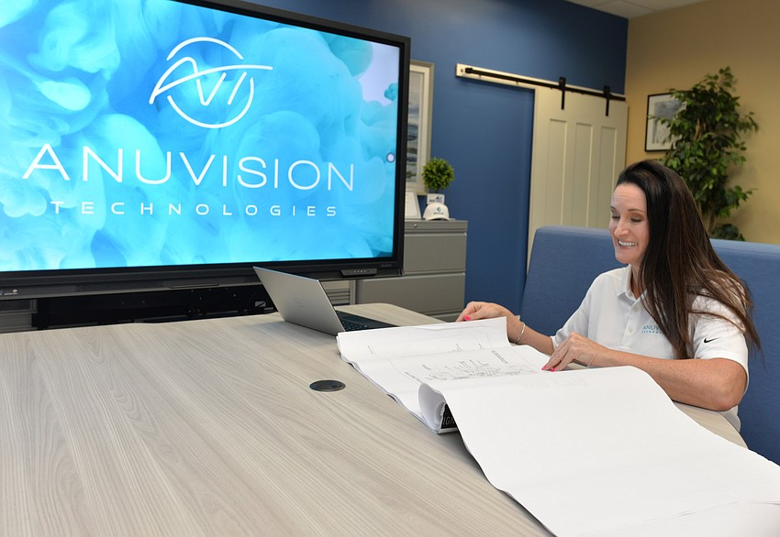
GROWTH
&THE FUTURE
  The Beginning
  Expanding
AnuVision's launch was a testament to the power of persistence and community during the challenging times of starting a business amidst a pandemic. In the initial days, the focus was to figure out how to scale years of experience in the industry to a full blown business model that could handle even the largest contracts.
Of course obtaining key certifications and securing the necessary funding are all necessary steps, however without the correct team to handle the work, this dream was never going to grow. Through leveraging existing contacts and building new community partnerships, along with loads of strategic planning and organization, AnuVision Technologies was able to not only start winning business, but also flawlessly execute these contracts.
As Anuvision entered its second year, the emphasis shifted towards growth and expansion. The company successfully moved from 3 employees to 8, expanding operations within the city, surrounding counties, and even venturing across the state. However, the rapid growth posed challenges, one specific example in terms of warehouse space. Here, the solution lies in its community relationships with chamber companies, such as Airvan. Leveraging these connections, and building contracted partnerships, we were able to build, install, and manage inventory across town and the state. These collaborations not only helped Anuvision meet the surging demand and growth trajectory but also helped empower the same goals with fellow local businesses named as these key partners.
  Today, AnuVision stands as a thriving organization with 18 dedicated employees. The company will move into a new building as of January 2024, complete with a warehouse and Jacksonville’s first emerging Experience Center. This Experience Center will highlight the future of technology and innovation, alongside the dozens of local companies that will be able to leverage and showcase the space as some of their own work and capabilities. The Experience Center is committed to sustained growth while fostering a supportive community and sharing success with the local business ecosystem.
  Building Up Jax
Summer Vyne
09 of 17

Slide 10
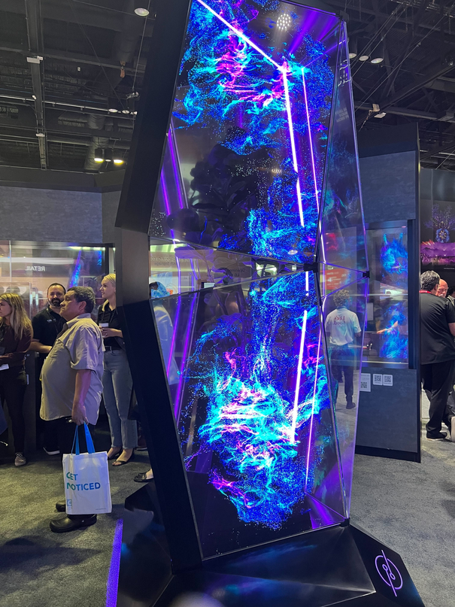
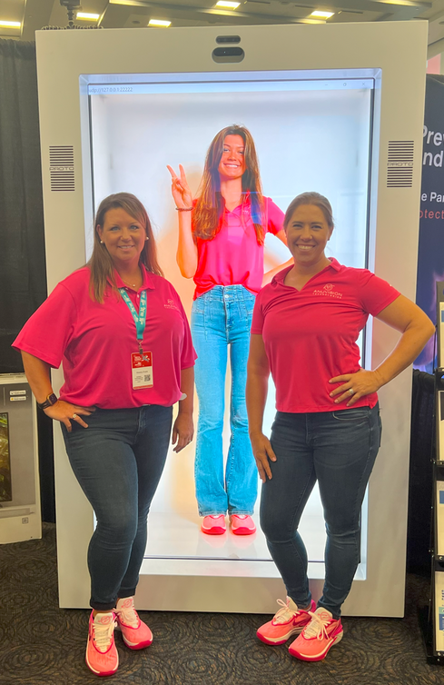

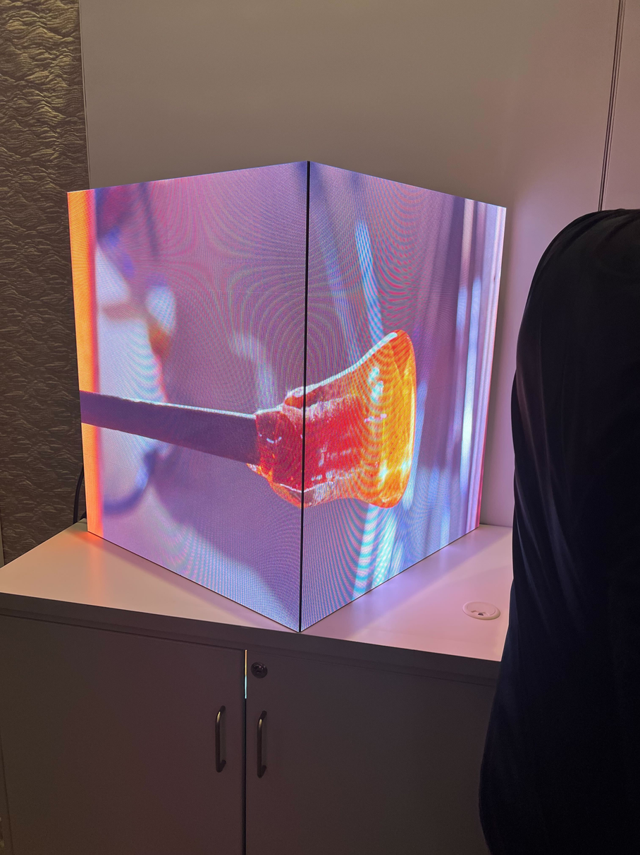
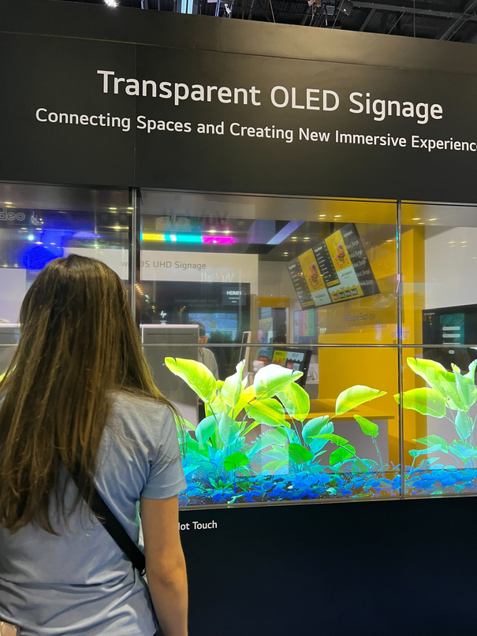
INNOVATION
EVOLVING JAX
  Ever Standing Out
While the hardware we offer is not our exclusive named technology, our true value as a VAR (Value-Added Reseller) lies in the expertise, service, and tailored solutions we provide to our clients. We recognize that in a market saturated with similar products, differentiation is not about the physical devices but rather the value AnuVision can create. In my roles prior to being an entrepreneur, I helped design and plan a showroom experience of these tech brands. From there I turned it into a mobile buildout NASCAR trailer for onsite demos. Now as my own independent VAR I am yet again going to change the expectation of what a showroom use to be and create an Experience for Jacksonville.
  Promise To The Community
The creation of our new Experience Center is meant to mark a milestone, by promoting AnuVision Technologies to new heights , as well as leading in collaboration for our community. This state-of-the-art facility is designed not only to enhance our internal operations and foster creativity but also to serve as a dynamic hub for our valued partners across diverse industries. By providing a welcoming environment, equipped with cutting-edge technology, our partners in product, design/architecture, construction, managed tech services will have the opportunity to showcase their spin to these future products and we all can serve them to clients and teams. This synergistic space is not just about advancing our individual interests; it's a testament to leading in collective growth.
Moreover, the inclusion of dedicated classrooms within the center will bring versatile spaces which will host a variety of shared events aimed at empowering individuals, fostering continuous learning, and facilitating networking opportunities. All to help expand the same community engagement that led me to where I am today. In essence, our Experience Center is our contribution to evolving Jax to further connect, grow and prosper.
  Your Name, Your Logo, Your Experience
  As top fortune tech companies release new innovating products, oftentimes to witness a demo you need to travel to a ‘Miami’, or an ‘Atlanta'. AnuVision is building a new Experience Center to counter this problem in our own backyard.
  The center will bring tangible examples of how technology seamlessly integrates into various industries. In addition to modeled rooms, an elevated stance will be played in personalization—envision a demonstration uniquely tailored to your brand. Watch as the room transforms with your company colors, logo, and promotional videos playing throughout. This is not just a display; it's an immersive EXPERIENCE through the possibilities of exploring what new technology can build for your business.
Summer Vyne
10 of 17

Slide 11
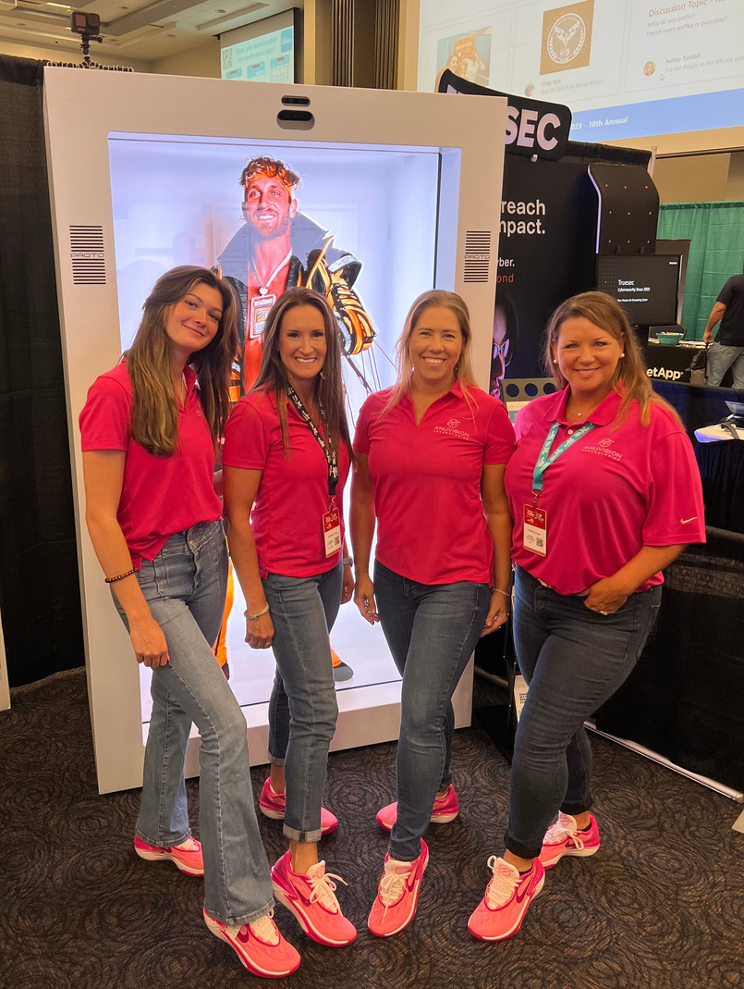
STATEMENT OF MERIT
SBLY 2023
I would like to express my enthusiasm and gratitude for the opportunity to be considered for the overall title of 2024 Small Business Leader of the Year. It would be an absolute honor to receive this recognition from the Jacksonville Chamber, an organization that I hold in the highest regard for its dedication to fostering growth and prosperity in our vibrant community.
Being a woman-owned and Native American-owned business has been a source of pride and inspiration for me. Throughout my professional journey, I have sought to not only break barriers but also to serve as a role model for aspiring entrepreneurs from underrepresented communities. This recognition would not only be a personal achievement but an award for highlighting the importance of diverse voices in business.
All my leadership efforts, starting in my early career to AnuVision Technologies, have been driven by the belief that authenticity and integrity strengthens our community and enhances our collective ability to innovate and succeed. As a leader for businesses and individuals alike, I have actively promoted education and personal growth within my own team, fostering an environment where unique perspectives are celebrated, and everyone has the opportunity to thrive.
I am passionate about using this title to advocate for fellow small businesses and empower women to succeed in technology. I envision leveraging this platform to create mentorship programs in my own Jacksonville IT Council that specifically target students expanding into technology, providing them with the support and guidance they need to navigate and thrive in this dynamic industry.
My leadership philosophy is rooted in the idea that success is not only measured by personal achievements but by the positive impact we have on the broader community. Thank you for considering my application for the Overall 2024 Small Business Leader of the Year. I am eager to contribute to the continued success and growth of Jacksonville, and I am confident that together, we will continue to create a thriving and inclusive business community that benefits us all.
Summer Vyne
11 of 17

Slide 12
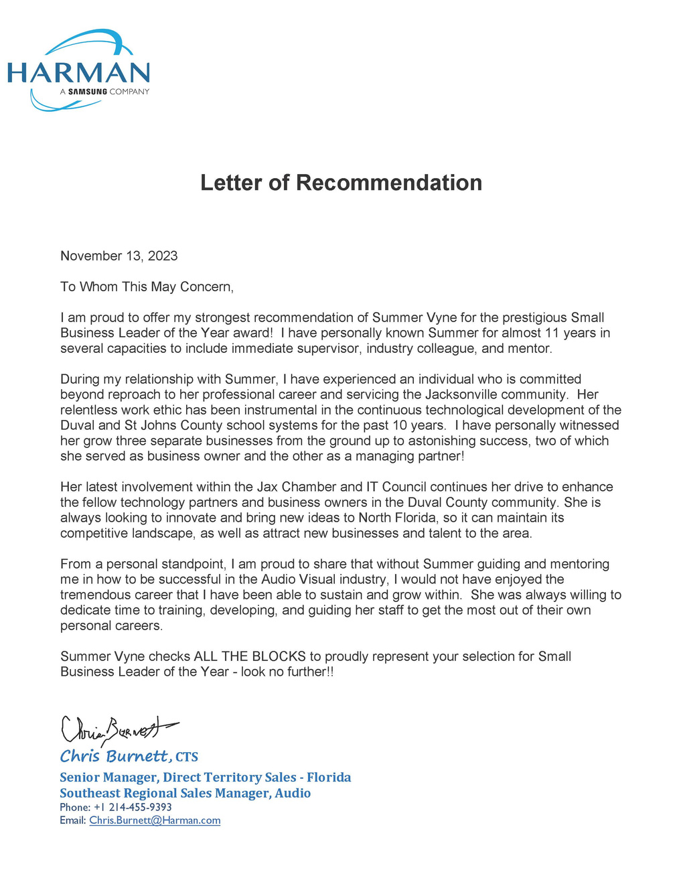
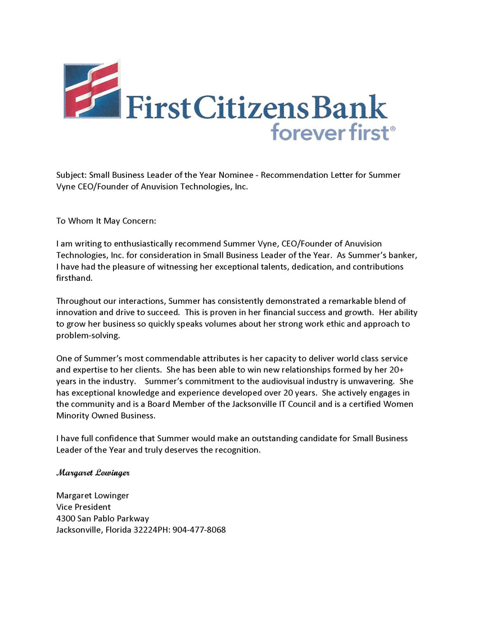
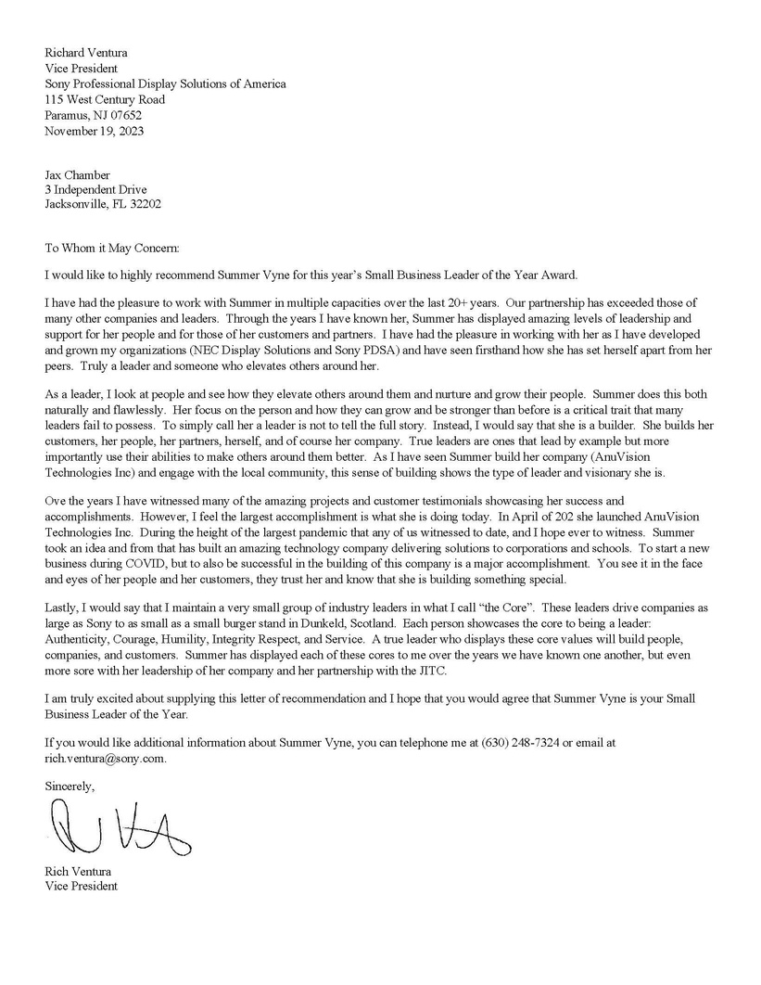
LETTERS
OF RECOMMENDATION
Summer Vyne
12 of 17

Slide 13
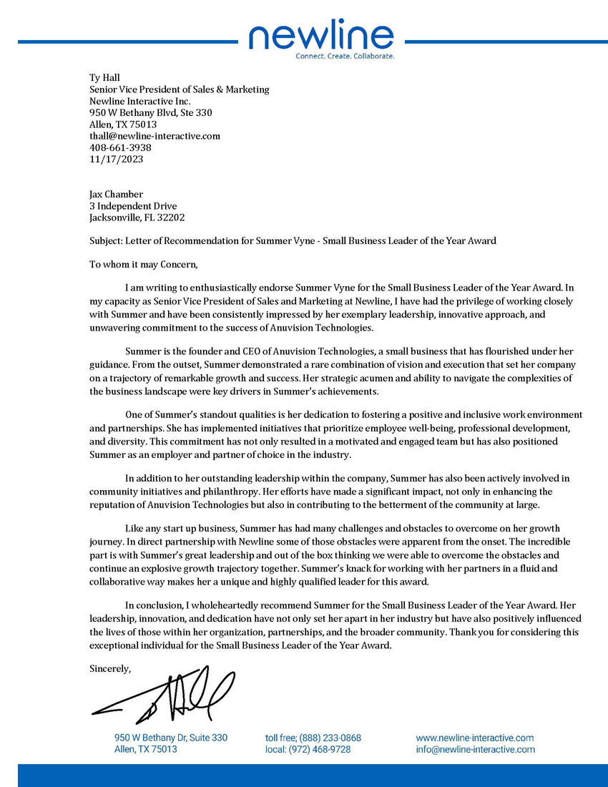
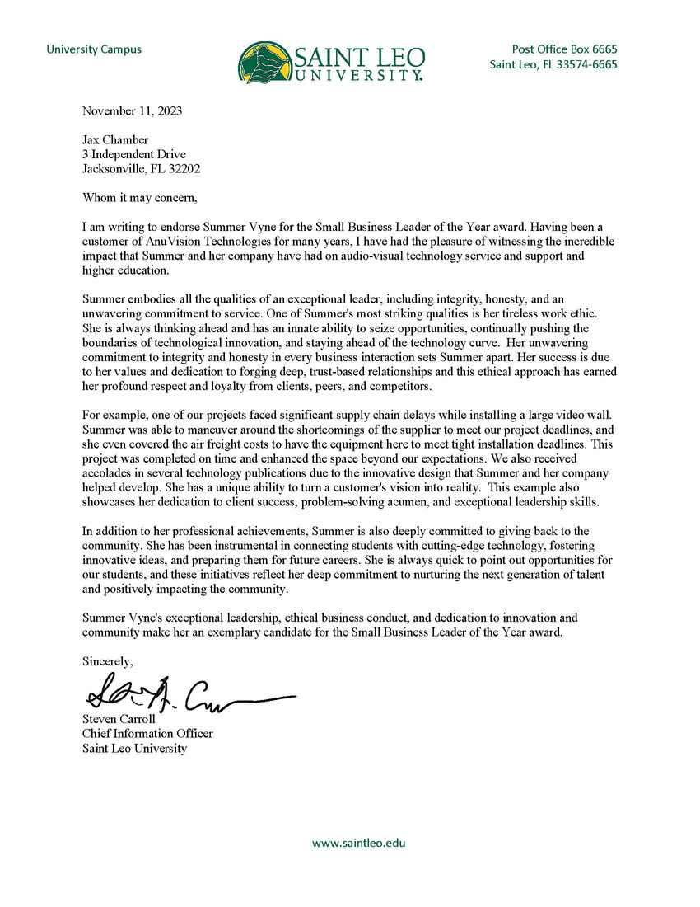
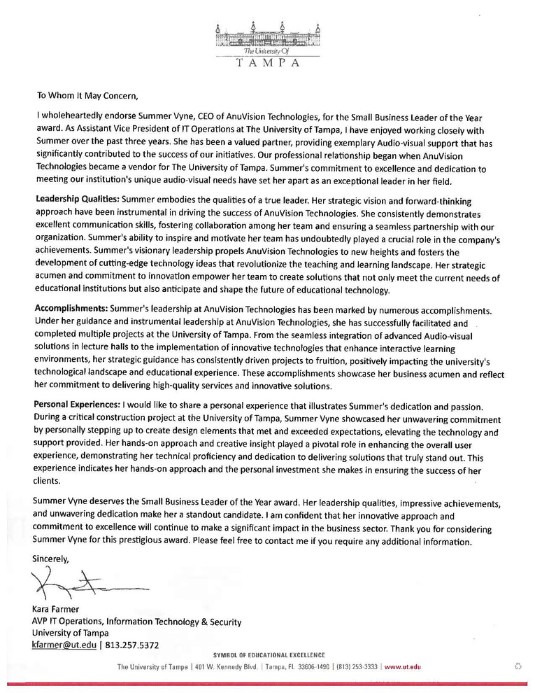
LETTERS
OF RECOMMENDATION
Summer Vyne
13 of 17

Slide 14
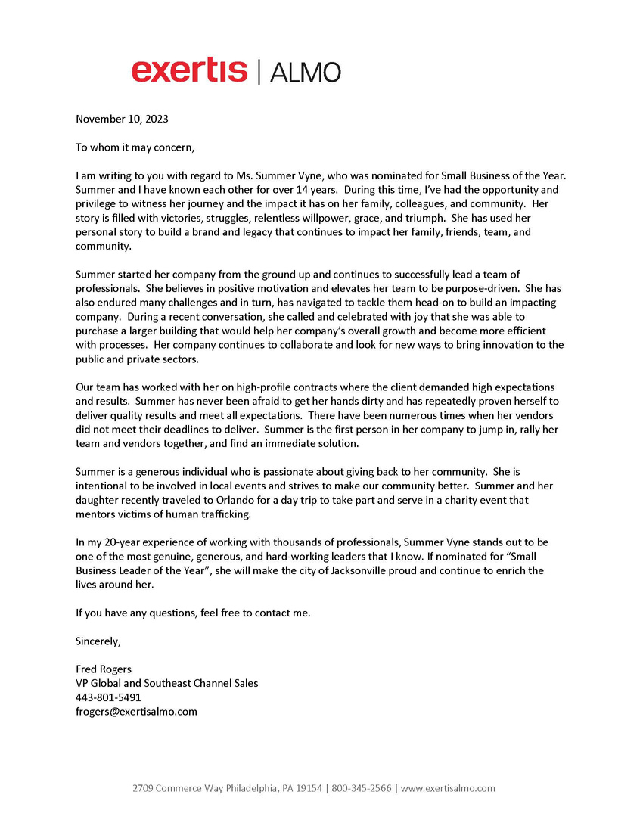
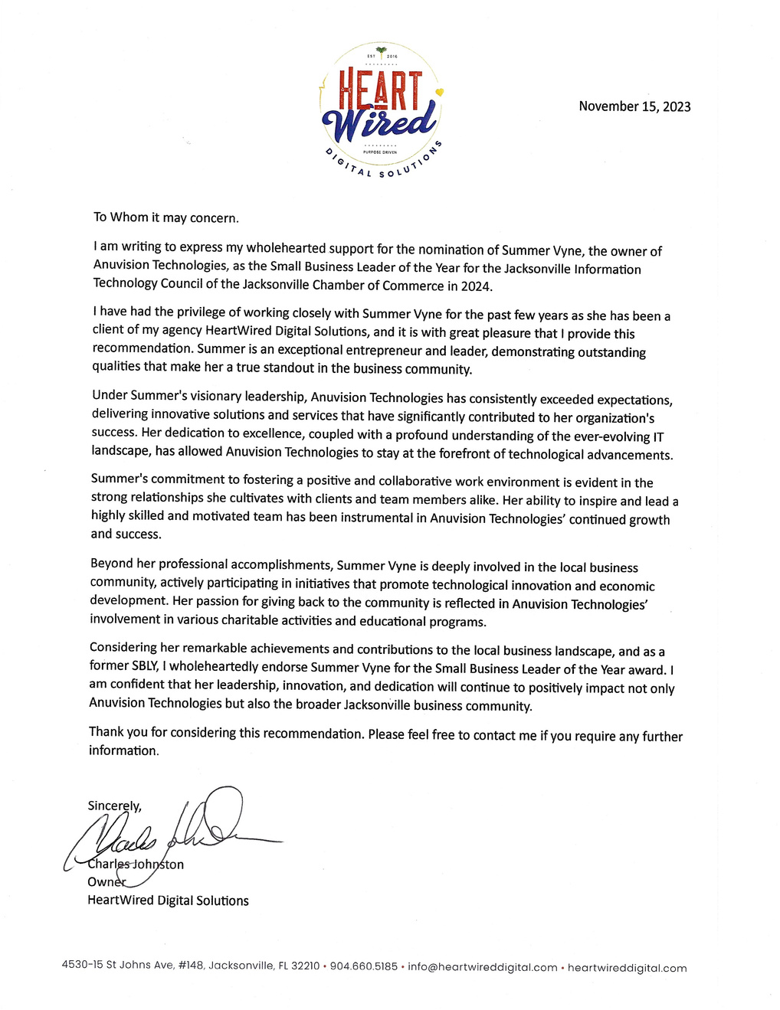
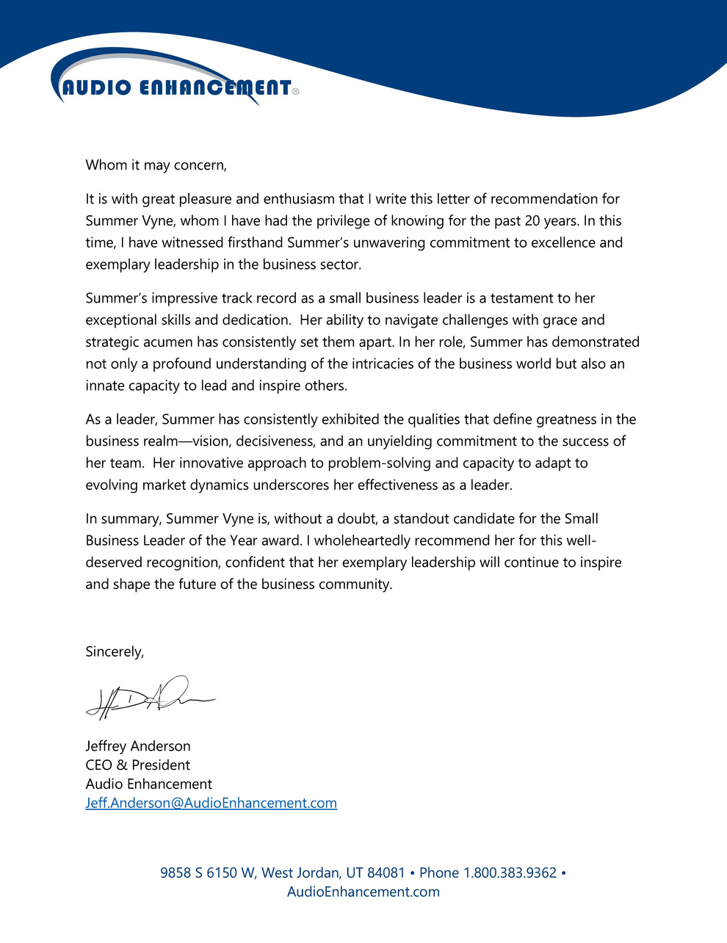
LETTERS
OF RECOMMENDATION
Summer Vyne
14 of 17

Slide 15

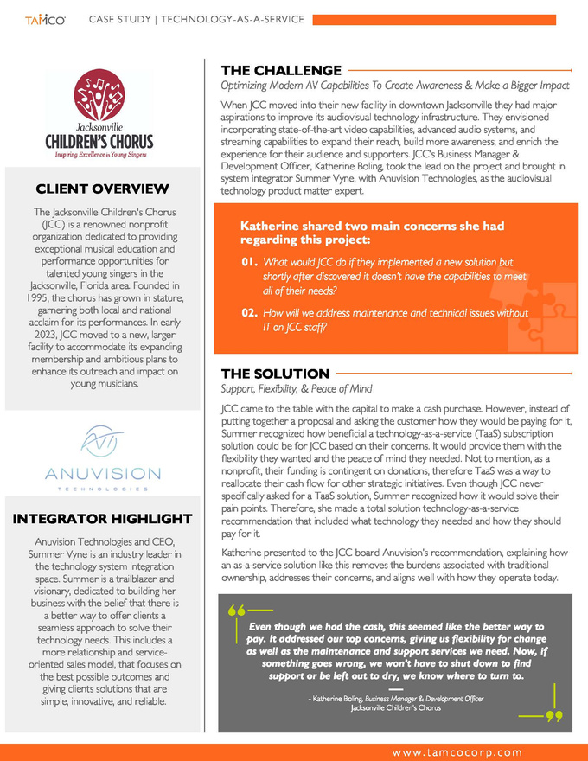
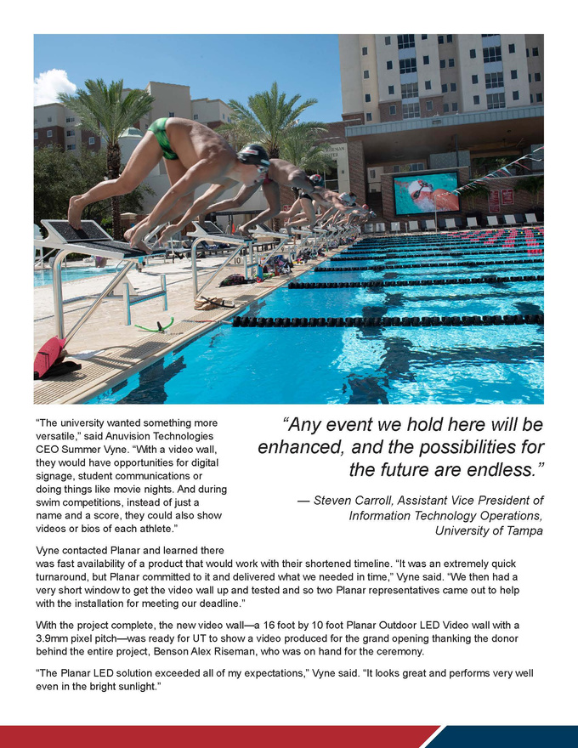
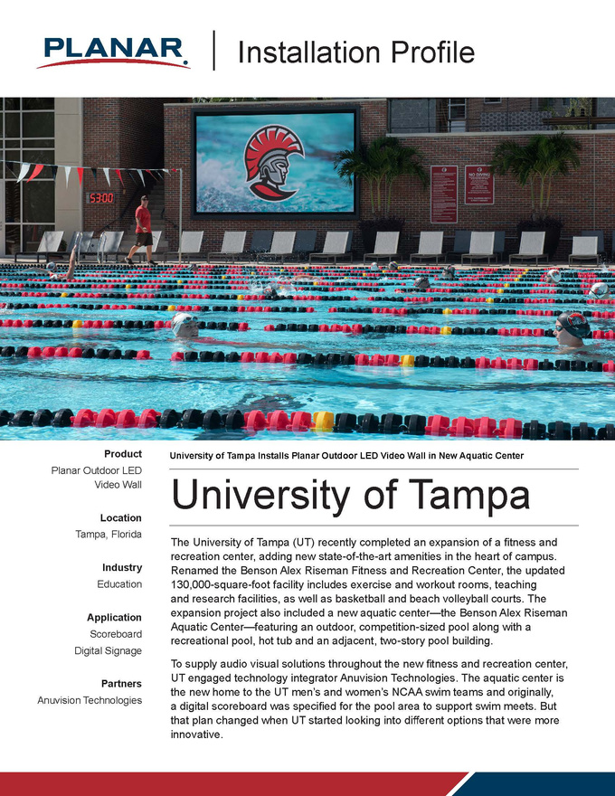
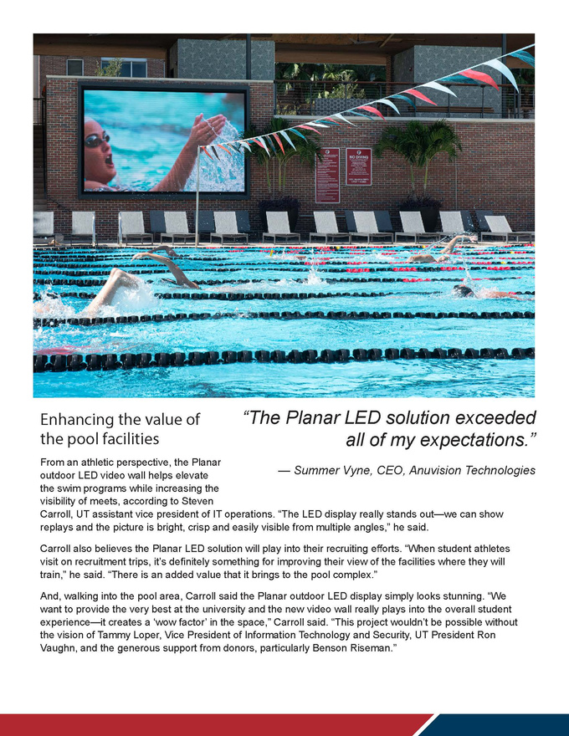
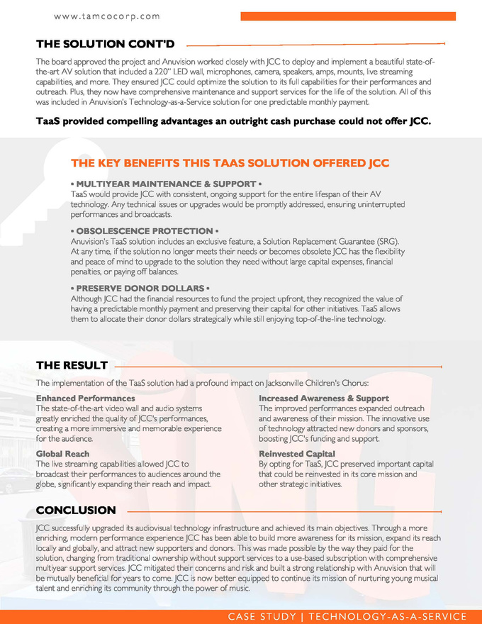
CUSTOMER
CASE STUDIES
Summer Vyne
15 of 17

Slide 16
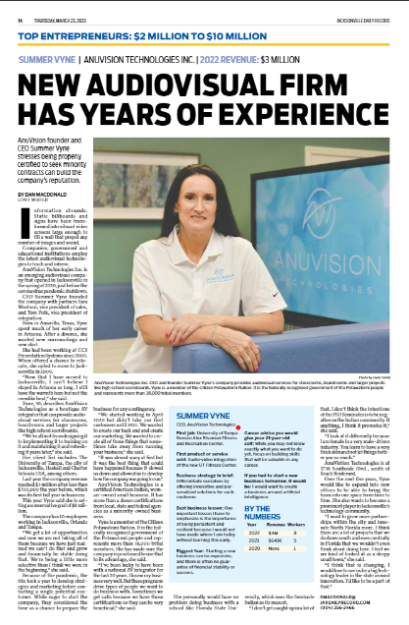
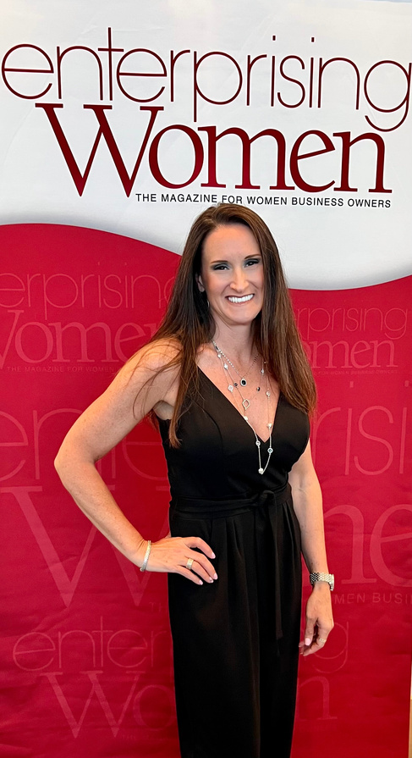


RECOGNITIONS
& AWARDS
  Enterprising Women of the Year 2023
  Top Entrepreneur in $2-10M - Jax Daily Record 2023
  Compass Top Contractor 2022
  Received an award in Canada for the “Best Educational Web Site of the Year 1998. Featured in the Heller Reports, September 1998 – http:///HellerReports.com
Summer Vyne
16 of 17

Slide 17


Summer Vyne
CEO
2023 Small Business
Leader of the Year

